Slide 1
Build and modernize intelligent apps

Slide 2
Every app will be reinvented with AI
New apps
will be built that weren’t possible before

Slide 3
Intelligent Apps
Use natural language
Driven by data Personalized

Slide 4
AI transformation opportunities
Enrich employee experiences
Reinvent customer experiences
Reshape business processes
Bend the curve on product innovation

Slide 5



Intelligent apps enable companies to…

Slide 6





…reinvent customer experiences
Personalization & product discovery
Content generation & marketing
Service & support
Build your own copilot

Slide 7

…reimagine customer experiences
Personalization & product discovery
Content generation & marketing
Service & support
Build your own copilot
Deliver personalized shopping experiences for customers by analyzing data on their behaviors and preferences and leveraging semantic search capabilities
Engage customers and present fashion recommendations based on trend data
Create personalized marketing content across platforms, from social media posts to product descriptions
CarMax uses AI to produce content for car research web pages
Provide personalized and interactive responses to answer customer questions and facilitate routine tasks
30% cost reduction for customer support interaction³
Go beyond bots to chat with your data using natural language, generate and summarize content, surface information over vast amounts of data, and provide engaging experiences
TomTom’s Digital Cockpit understands 95% of complex requests, improving response time from 12 seconds to 2.5 seconds⁴

Slide 8

Customer story
“Having a conversational interface option gets us closer to our goals of fully engaging the customer and personalizing their experience by showing them the most relevant products at the most relevant time.”
Cliff Cohen, Chief Technology Officer, Asos

Slide 9





…reshape business processes
Transaction processing and anomaly detection
Information discovery and knowledge mining
Document intelligence and summarization
Build your own copilot

Slide 10

Use case background
Build your own copilot
Streamlined employee access to information about internal policies, and internal documents
70 percent of KPMG’s employees have adopted KymChat, making over 120,000 requests since its release¹
Transaction processing and anomaly detection
Handle high volumes of transactions swiftly, accurately, and reliably
Manulife data scientists now take only days to set up an environment, making it much easier to detect fraud²
Information discovery and knowledge mining
Transforms unstructured data, such as orders, contracts, applications, and forms, into structured digital information
H&R Block tax professionals to find detailed client history in seconds and helps them sort through stacks of forms in seconds³
Document intelligence and summarization
Automates extraction, aggregation, and summarization of data from various sources, such as webpages, contact center logs and internal documents
Using conversation intelligence to surface keywords and other relevant conversation data to help spot trends and quickly get a pulse on their customers.⁴

Slide 11

Customer story
“When you run a customer services operation, making the customer feel like you have their undevoted attention is crucial. GenAI allows us to do that and more—helping us to empower our agents to deliver the best possible services and make our customers happy.”
Jörg Kramer, Chief of Customer & Commercial Operations, KPN

Slide 12




…bend the curve on product innovation
AI-enabled
services
AI-enabled automation
Build customer copilots

Slide 13


Use case background
AI-enabled services
AI-enabled automation
Build customer copilots
Create unique AI enabled services tailored to the business needs of your customers
Canary Speech uses AI to help medical practitioners assess and monitor real-time data for early disease detection
Leverage AI to make product workflows more efficient
Modern Requirements helps customers automate repeatable steps in product lifecycle management
Utilize your unique expertise to offer customers solutions through custom copilots
Icertis helps customers drive efficiencies in the contract management process, reducing costs and minimizing risks

Slide 14


Customer story
“We expect customers to see contract reviews accelerated by up to 40 percent... Perhaps more importantly, they can also discover and manage their risks better than ever before and then take it a step further by suggesting mitigation of those risks.”
Monish Darda, Cofounder and Chief Technology Officer at Icertis

Slide 15
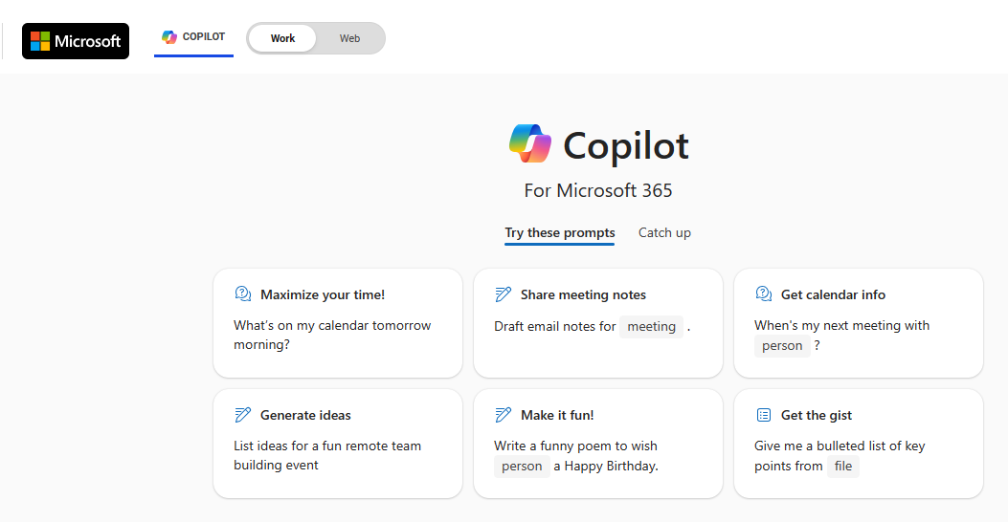
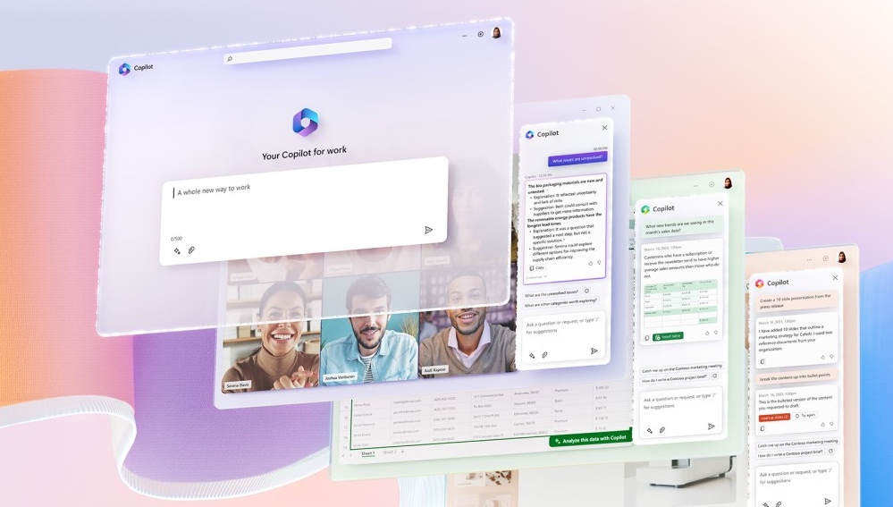

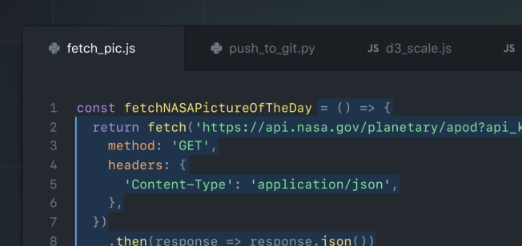
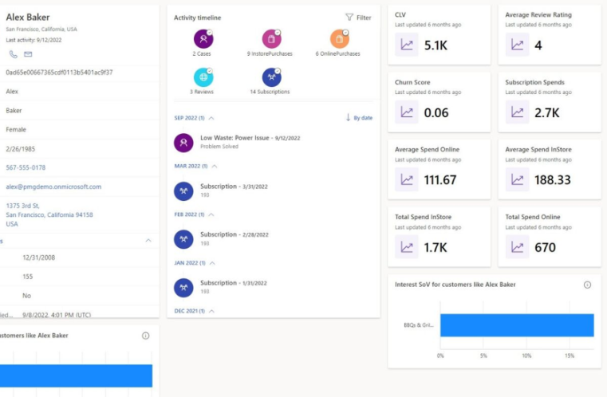
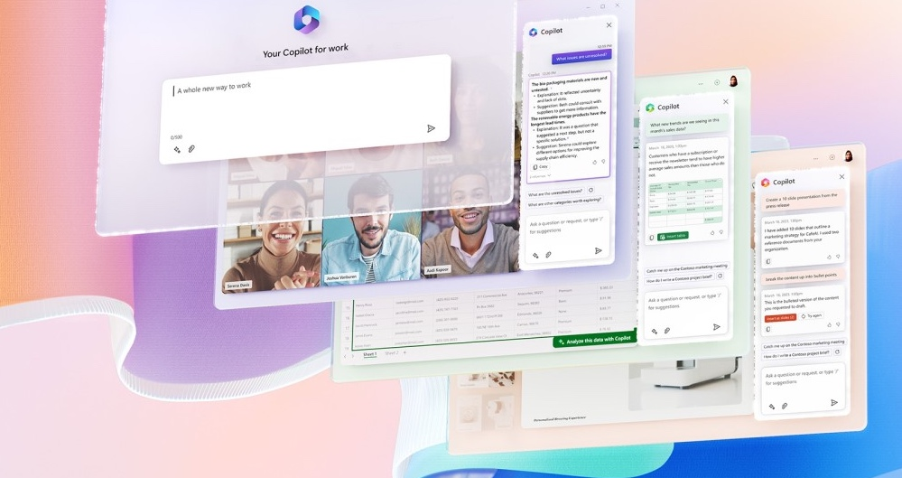
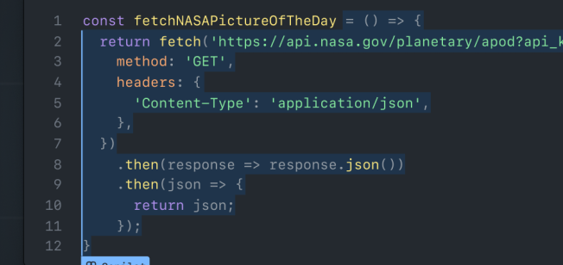
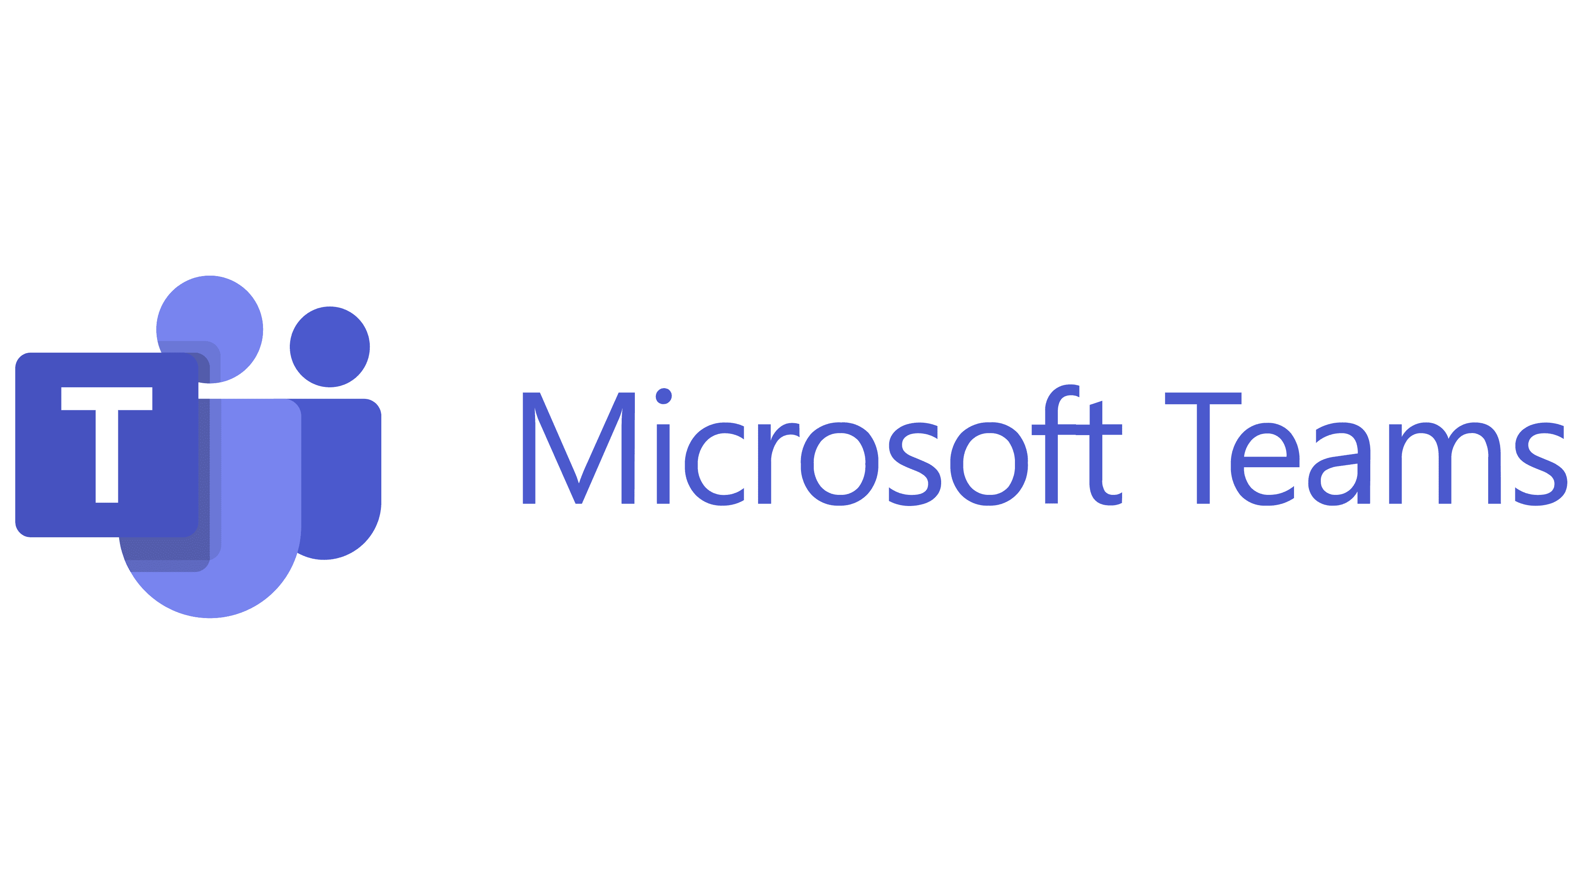





Microsoft product experiences
Microsoft is reimagining our product experiences with generative AI
Microsoft Copilot
Copilot for Microsoft 365
Copilot in Microsoft Teams
Copilot assisted coding
Microsoft Dynamics 365

Slide 16
Intelligent apps are transforming many industries…
Employee Copilot
Knowledge search
Document intelligence
Personalized care
Demand forecasting
Support chatbot
Hyper personalization
Factory AI Assistant
Content generation & marketing
Energy
Healthcare
Visual inspection & anomaly detection
Retail associate Copilot
Field service Copilot
Retail
Manufacturing
Document processing
Customer agent Copilot
Fraud detection
Customer call summary
Wealth advisor
Financial Services
Telecommunications
Support chatbot

Slide 17
This transformation to intelligent apps is accelerating
1Bn
80%
89%
New logical apps forecasted to be created by 2028¹
“By 2026, more than 80% of enterprises will have used generative AI APIs, models and/or deployed GenAI-enabled applications in production environments, up from less than 5% in 2023”²
Enterprises accelerating or maintaining application modernization investments over the next year³
https://www.idc.com/getdoc.jsp?containerId=US51953724
Gartner™: Top Strategic Technology Trends for 2024, 16 October 2023. GARTNER is a registered trademark and service mark of Gartner, Inc. and/or its affiliates in the U.S. and internationally and is used herein with permission. All rights reserved.
Unlock Competitive Advantage With Application Modernization - A commissioned study conducted by Forrester Consulting on behalf of Microsoft, 2024..

Slide 18

Intelligent apps transformation requires
Business outcome and use case alignment
Latest innovation in AI models and responsible AI
Skilling and tools for developers to build faster
Leveraging existing applications and data sources
Enterprise security, scale and performance

Slide 19
Deliver business value faster with Intelligent Apps on Azure

Slide 20
Develop intelligent apps faster
50%
1.5
150%
Less time in developing new applications¹
Months faster to market for new apps²
Increase in work output due to Azure AI³
The Business Value of Migrating and Modernizing to Microsoft Azure – IDC
The Total Economic Impact™ Of Microsoft Azure App Innovation - A commissioned study by Forrester Consulting, 2024. Results are for a composite organization.
The Total Economic Impact™ Of Microsoft Azure AI - A commissioned study by Forrester Consulting, 2024. Results are for a composite organization.

Slide 21



Azure AI application platform
Developer tools
Azure
App
platform
Data
platform
AI platform
Visual Studio
Infrastructure
Partner Tools and Services
Security, governance and responsible AI

Slide 22

Comprehensive capabilities to deliver intelligent apps
Intelligent app use cases based on customer engagements
End to end security across the application lifecycle
Earlier access to AI innovation and broadest selection of AI models
Extensibility and open ecosystem with partners
Unmatched performance and resilience for databases
Any developer, any app, any architecture and language

Slide 23










With Azure, the latest open-source and foundation models are under one roof
Microsoft Family
Cost-effective, domain-specific SLM efficiency.
Meta Family
Use case versatility, open-source ethos and safety.
Nvidia Family
High-quality, reliability and designed for optimization.
Azure OpenAI Family
Multimodal GenAI, privacy, security and enterprise scale.
Cohere Family
Performance, low-latency
and built-in grounding.
Databricks Family
Expertise in enterprise workloads and databases.
Mistral Family
Exceptional language and multilingual reasoning.
Hugging Face Family
Open-source options that are accessible and adaptable.
Snowflake Family
Cost-effective training, helpful coding and resources.
Image generated with AI using Microsoft Designer

Slide 24
Become AI ready by modernizing your application estate

Slide 25
Modernizing app and data estate for AI
61%
51%
46%
Modernizing to infuse GenAI Capabilities²
Less time developing new features¹
Less time in developing new applications¹
The Business Value of Migrating and Modernizing to Microsoft Azure – IDC
Unlock Competitive Advantage With Application Modernization - A commissioned study conducted by Forrester Consulting on behalf of Microsoft, 2024.

Slide 26



Azure can help you modernize your application estate
Increase innovation agility for business-critical apps and become AI ready
Reduce cost and complexity barriers to modernization
Modernize quickly by leveraging existing technology skillsets
Rearchitect to modern application architectures
Continuously deploy new features and infuse AI faster
Performance and scale to meet business needs
Re-platform multiple apps with minimal application changes
Gain operational efficiency and optimize cost
Increase reliability, security and performance
Leverage existing application development skills
Enhance productivity and reduce tech debt
Utilize existing database expertise

Slide 27
Azure can help you modernize your application estate
Increase innovation agility for business-critical apps and become AI ready
Reduce cost and complexity barriers to modernization
Modernize quickly by leveraging existing technology skillsets
“With Azure, our customers can submit more documentation online, and we can then use document analysis to extract information and conduct processing to accelerate workflows, ensure accuracy, and improve user experiences.”
“With our migration to PaaS, we got what we wanted: greater scalability, reliability, security, agility in managing our IT infrastructure—and greater peace of mind—all without the cost and hassle of doing this ourselves.”
“Nobody understands .NET and SQL Server better than Microsoft, which, through Azure, gave us a robust set of managed services for migrating our legacy applications to the cloud.”

Slide 28
Microsoft’s app modernization journey
2000+
Line-of-business applications
8
On-prem datacenters worldwide
40K
Distinct operating system instances
>2K enterprise LOB applications including complex and customized LOB applications, CRM, Office servers, Portals and SPS
Applications spread across eight on-prem datacenters worldwide
Applications consisting on a combined 40,000 distinct operating system instances

Slide 29
Manage and scale intelligent apps securely

Slide 30
Streamline operations and increase efficiency
25%
27%
87%
Reduction in downtime for intelligent apps¹
Fewer security breaches²
Less time in deploying IT resources²
The Total Economic Impact™ of Microsoft Azure App Innovation, a commissioned study conducted by Forrester Consulting, 2023. Base: 114 developer managers and executives
The Business Value of Migrating and Modernizing to Microsoft Azure – IDC

Slide 31
Azure AI app platform capabilities can help with
Scale and performance
60+ regions
SLAs up to 99.999%
DBs with <10ms latency
Code to cloud security
Code security
Threat protection
Responsible AI
Content safety
AI-assisted operations
Governance
Cost Management
Observability
Microsoft Copilot in Azure

Slide 32


Customer story
“When managing on-premises systems, we had to handle upgrades, security patches, immediate fixes, and regular maintenance. In Azure, many of these tasks are handled behind the scenes, reducing the operational load on our team. Maintenance efforts have been significantly reduced.”
Ulaş Ergin, IT, Digital Banking and Software Architecture Department Manager, Credit Europe Bank NV

Slide 33

Achieve global-scale innovation on state-of-the-art cloud platform, reaching customers around the world
60+
300+
100+
Azure regions
Compliance certifications
datacenters
Application service availability SLAs up to 99.95% | Databases with availability SLAs up to 99.999%

Slide 34
Secure your AI applications from code to cloud
Development
Cloud
AI
Code security
Dependencies security
Embedded secrets protection
Developer remediation
Application security posture management
Infrastructure- as-code security
Code to cloud remediation workflows
Responsible AI toolbox
Responsible AI standard
Azure AI content safety
GitHub advanced security
Defender for cloud
Responsible AI

Slide 35

Integrated platform capabilities Enforce policy, monitor app performance, and optimize costs
Governance
Observability
Cost analysis
Policy management
Monitoring
Cost management
Data governance
Application insights
Recommendations
AI assisted operations
Microsoft Copilot for Azure

Slide 36
Realize the power of AI apps for your business today

Slide 37
Follow the right steps to drive value for your business
Identify AI app use cases
Assess your app landscape
Leverage an integrated AI app platform
Optimize operations
Align your AI app uses cases business outcomes with technical patterns and case studies.
Assess your current application landscape and develop a strategy to build new or modernize.
Build and modernize with an integrated AI app platform, scalable data services, and pretrained and responsible AI.
Leverage operational best practices for enterprise-grade scale, performance and security.

Slide 38
Get started with Azure Innovate
Envisioning workshop
Connect your desired business outcomes with possible solutions
Proof of concept
Put your intelligent apps vision into action with a technical pilot
Move to production
Leverage funding and partners/implementation resources to move from pilot to production

Slide 39
Take advantage of extensive Azure resources
Offerings
Offers
Partners
Guidance
Skilling
Azure Innovate
Build and modernize AI Apps https://aka.ms/AzureInnovateOffering
GitHub Copilot + AKS
Save on GitHub deployments to AKS
Advanced Specialization
Certified Apps, Data, and AI partners
Reference architectures
Leverage enterprise-grade best practices and Designated Engineering offers
Transform with Microsoft AI
Apply AI to drive business outcomes
Microsoft Unified
Accelerate your success with expert-led support services
Azure AI Advantage
Get up to $6,000 of Azure Cosmos DB service for 90 days
Partner App Deployment
Funding for deployment through Azure partners
Optimization guidance
Maximize your cloud investment
Microsoft Learn
Self-paced training and docs

Slide 40
Thank you

